Slide 1
Year 10 into 11 Information Evening
June 6, 2023

Slide 2
Principal’s Welcome

Slide 3
Acknowledgement of Country

Slide 4
College Prayer
Dear Lord,
Grant that we may live each day to the full, inspired by the Holy Spirit.
Let us cast away all worries and concerns into your divine care.
All: Christus Lux Mea
Give us strength to confront all challenges that we face with hope and faith.
Let our community seek truth in all that we search for.
All: Christus Lux Mea
Let us stand for others always giving generously without counting the cost.
Blessed Edmund Rice…Pray for us
Live Jesus in our Hearts …Forever.

Slide 5
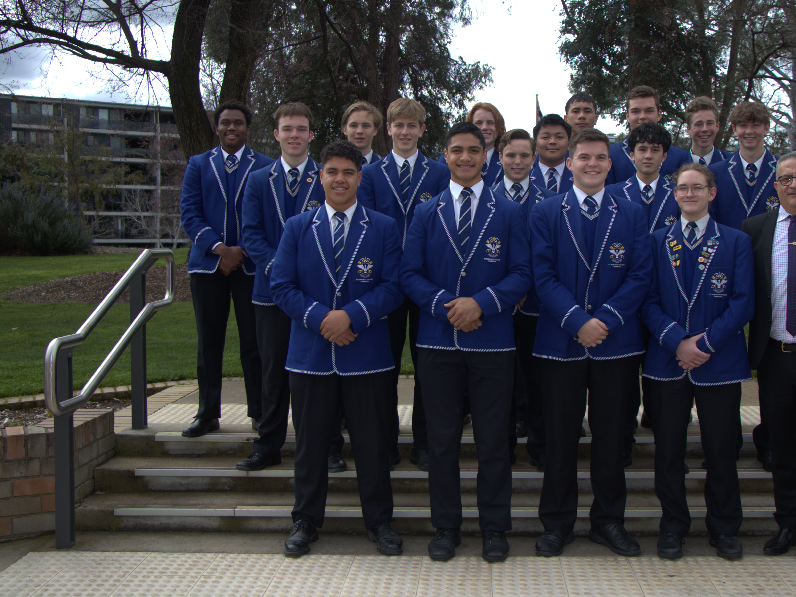
Student Perspective
Vice-Captain, Liberating Education
Hamish Chapman

Slide 6
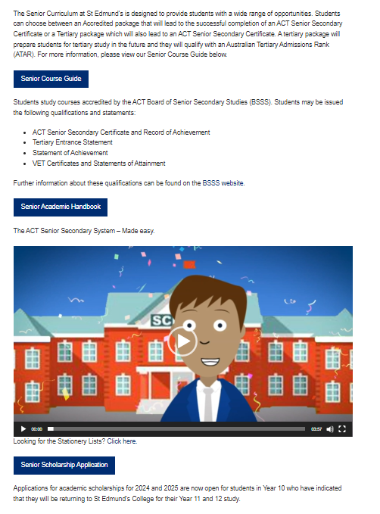
The Senior School Section of our Website
https://sec.act.edu.au/academic/senior-school/

Slide 7
From Mr Masters
Check out the College Careers website with your sons: www.seccareers.com.au
Next week students will complete their final future education and career pathways targeted lesson,

Slide 8
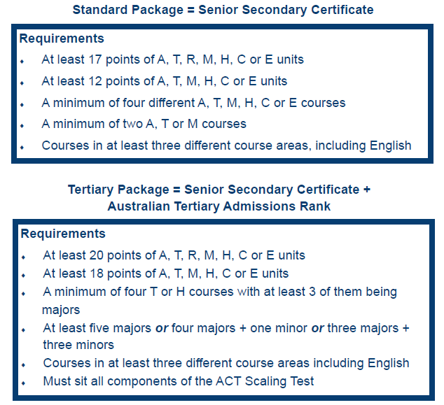
Intro to the BSSS
https://www.bsss.act.edu.au/

Slide 9
To ATAR or not to ATAR

Slide 10
Non-ATAR (Accredited) Package
Often accompanied with an Australian School Based Apprenticeship or other work transition options (Year 11 or 12)
Can include a mix of Tertiary (T) and Accredited (A) classes
A courses are less academically demanding than T
Doesn’t preclude university – eg Sports Academy, UC Connect pathways

Slide 11
ATAR Compliant (Tertiary) Package
Typically we recommend 5 Tertiary, 1 Accredited class to start.
Courses designed and taught with university preparedness in mind.
Course don’t scale, students in courses determine the scaling parameters

Slide 12
ATAR Calculation at a Glance
A student’s 3 highest Major Courses (studied 4 semesters) weighted at 1.0 each, plus the student’s 4th best course score of any that remain(Major or Minor) weighted at .6, creates an Aggregate Score.
The Course Scores are based on the student’s performance on assessment relative to the other students in his Scaling Group (z-scores), and that is scaled based on ACT Scaling Test (AST) results).
The BSSS compares ACT students’ Aggregate Scores to NSW data to generate an ATAR.

Slide 13
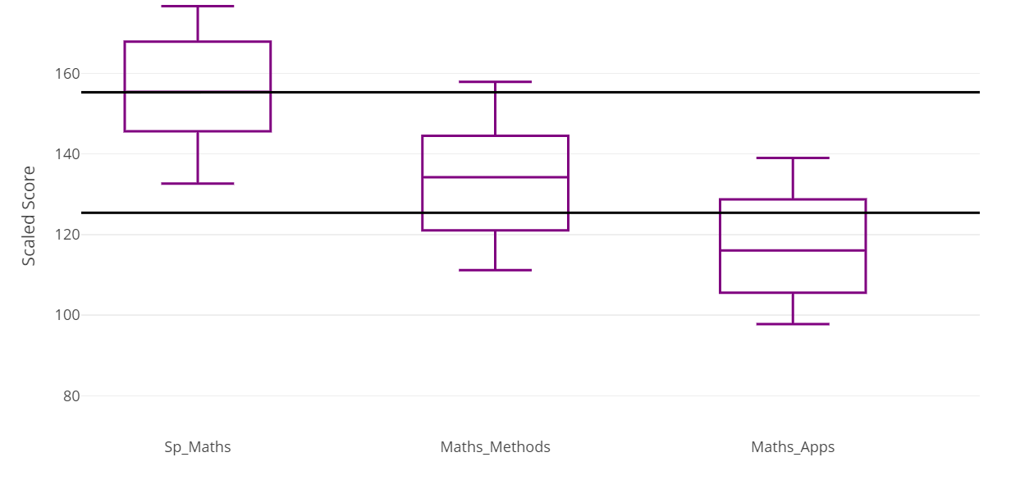
Advice: Choose the courses that bring the best out of you

Slide 14
Points where there is sometimes confusion
Courses don’t scale well. The performance of students who are in that course on their trial AST, on their assessment, on meshing tests, and on the AST is what determines how well a course scales.
Students are in control of their own destiny. With strong enough z-scores, and a strong performance in the AST, any student in the ACT can achieve a 99 ATAR.

Slide 15
Subject Selection Interviews June 19. Please nominate your availability via the Eddies Dashboard or, if you aren’t available on the 19th,we can organise a date and time that suits (same process either way)

Slide 16
St Edmund’s College Sports Academy
The St Edmund’s College Sports Academy provides an opportunity for our students to consider a sports-focused pathway that offers direct, non-ATAR entry to a number of undergraduate courses at the University of Canberra.

Slide 17
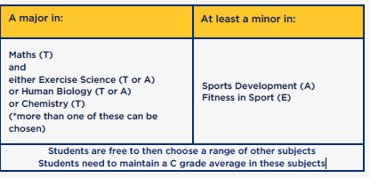
The Sports Academy is a package of subjects centred around a sports focus.
It will allow students to have a flexible approach to their learning but will need to meet specific criteria

Slide 18
Courses that will be included but not limited to this partnership pathway will include
MGB108 Bachelor of Business (Sport Management)
HLB101 Bachelor of Health Science (Human Movement)
274JA Bachelor of Sport and Exercise Science
321JA Bachelor of Primary Education
330JA.5 Bachelor of Secondary Education (Health and Physical Education)

Slide 19
Invitation for questions and discussion

